Slide 1
Endoplasmic Reticulum:- There are two types
Rough Endoplasmic Reticulum :- Network of continuous sacs, studded with ribosomes. Internal delivery system of the cell. Manufactures, processes, and transports proteins for export from cell. Continuous with nuclear envelope.
Smooth Endoplasmic Reticulum
Similar in appearance to rough ER, but without the ribosomes. Produces lipids, involved in carbohydrate metabolism, and detoxification of drugs and poisons.

Slide 2
5. Golgi apparatus:
The Golgi apparatus (GA), also called Golgi body or Golgi complex, is a series of three to twenty cup-shaped, membrane-covered sacs.
The inner face is directed to the plasma membrane. The GA processes, packages, storage, and distributes molecules about or from the cell.
It is also said to be involved in secretion.
It modifies proteins and lipids (fats) that have been built in the ER and prepares them for export as outside of the cell.
They also build lysosomes.
The number of GAs in each cell varies according to its function, but animal cells generally contain between ten and twenty per cell.

Slide 3
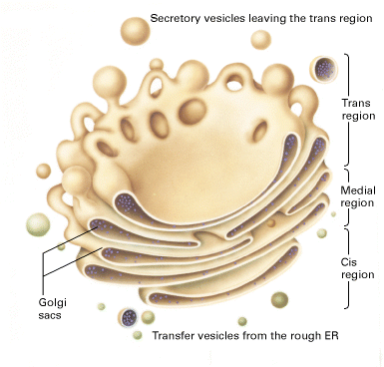
Golgi apparatus

Slide 4
6. Lysosomes:
A membrane-bounded organelle, produced by the golgi apparatus, found in the cytoplasm of eukaryotic cells,
it has a diameter of about 50–3,000 nm.
Lysosomes contain hydrolytic digestive enzymes.
It acts as the "garbage disposal" of the cell by breaking down cell components (proteins, lipids, carbohydrates and other macromolecules into simple compounds) which are then returned to the cytoplasm as new cell-building materials.
It also transports the undigested material for removal. Also Organelle that makes protein for the cell.
The interior of a lysosome is strongly acidic, and its enzymes are active at an acid pH. Lysosomes are found in all eukaryotic cells, but are most numerous in disease-fighting cells, such as leukocytes (WBC).

Slide 5
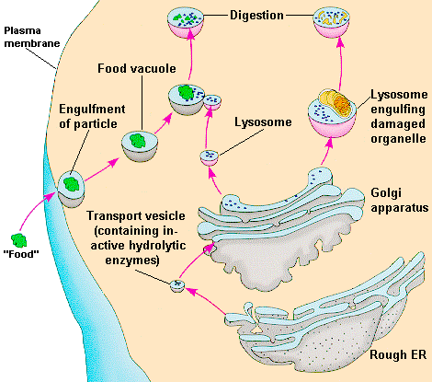
Lysosomes

Slide 6
7. Mitochondria:
The mitochondria are specialized, it has a diameter of about 1-2 µm, oval-shaped cellular compartments. Mitochondria have a double membrane, the outer membrane is smooth, the inner membrane called cristae contains numerous folding to increase surface area. Attached to the cristae are small granules of unknown composition and function. The mitochondria are responsible for the aerobic (oxygen dependent) metabolism of the cell. There is also some DNA present in the mitochondria which is probably responsible for the synthesis of messenger RNA necessary to produce protein enzymes. The fluid inside of the mitochondria is called the matrix.
acts like a digestive system that helps break down nutrients and other materials creating energy.

Slide 7
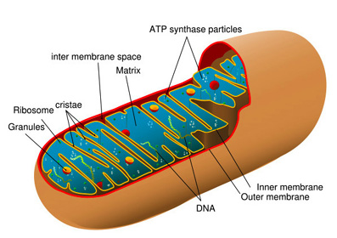
Mitochondria

Slide 8
8. Centrioles:
Centrioles are short cylinders with a 9+0 pattern of microtubules triplets. May be involved in microtubules organization and in the formation of cilia and flagella.
These paired organelles are typically located together near the nucleus in the centrosome. Within the centrosome, the centrioles are positioned so that they are at right angles to each other. Each centriole is made of nine bundles of microtubules (three per bundle) arranged in a ring.
Centrioles play notable roles in cell division. During interphase of an animal cell, also separate chromosome pairs during mitosis

Slide 9
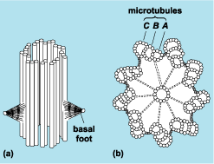
Centrioles

Slide 10
9. Cilia and Flagella:
Cilia are tail-like projections extending approximately 5–10 µm from the cell body. There are two types of cilia: motile cilia, which constantly beat in a single direction, and non-motile or primary cilia, which typically serve as sensory organelles.
Cilia and flagella are made up of microtubules, They have a 9+2 pattern of microtubules are involved in the movement of cells. there are composed of linear polymers of globular proteins called tubulin. The core (axoneme) contains two central fibers that are surrounded by an outer ring of nine double fibers and covered by the cellular membrane.

Slide 11
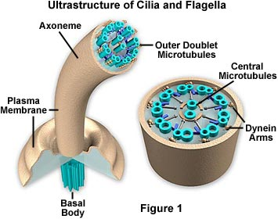
Cilia

Slide 12
10. Cytoskeleton:
The cytoskeleton is a network of interconnected filaments and tubules that extends from the nucleus to the plasma membrane in eukaryotic cell.
It is a dynamic structure that maintains cell shape, protects the cell, enables cellular motion (using structures such as flagella, cilia and lamellipodia), and plays important roles in both intracellular transport (the movement of vesicles and organelles, for example) and cellular division.

Slide 13
THE END!

